Slide 1
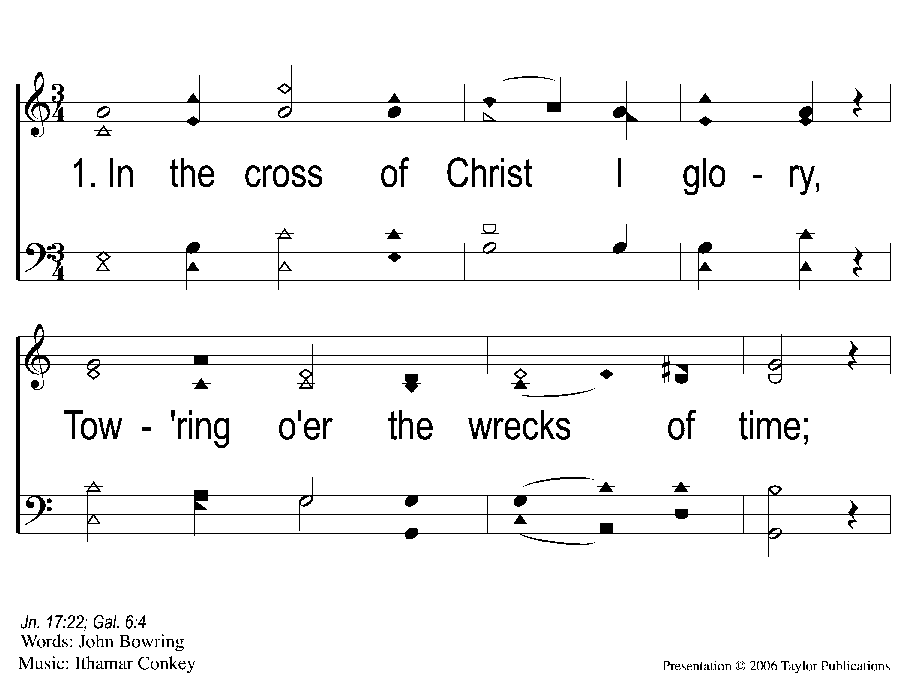
1-1 In the Cross of Christ
In the Cross of Christ I Glory
116

Slide 2
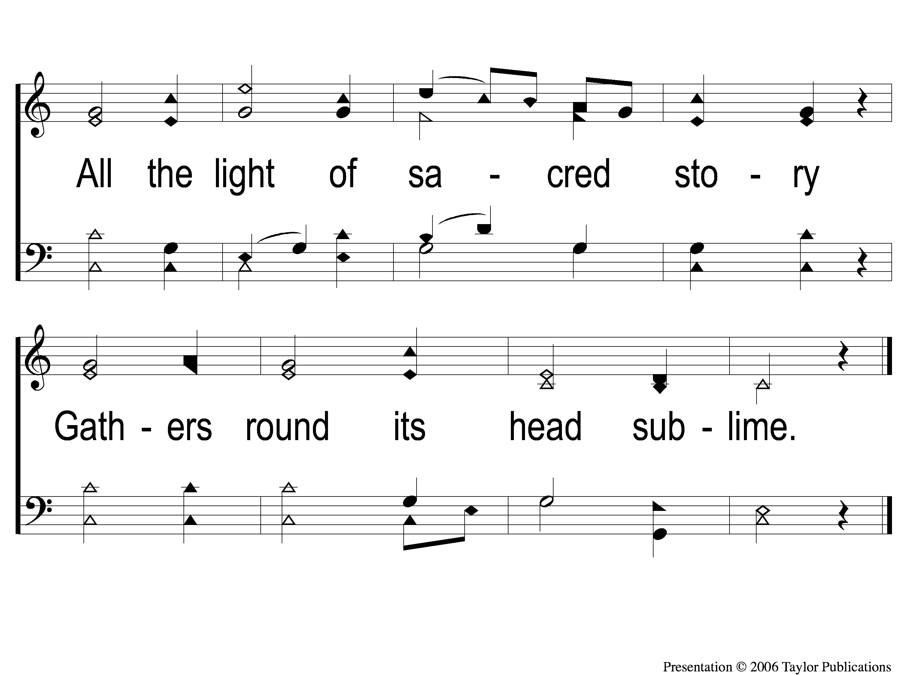
1-2 In the Cross of Christ
In the Cross of Christ I Glory
116

Slide 3
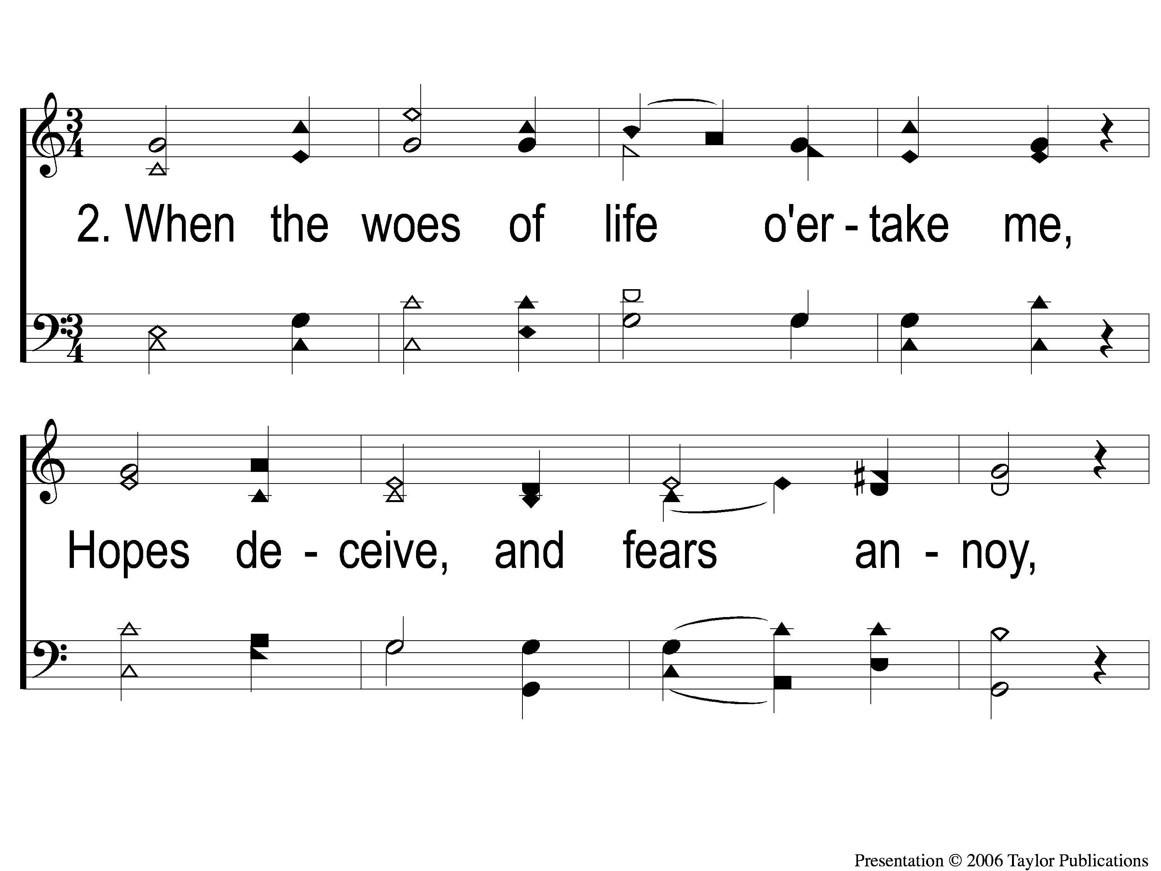
2-1 In the Cross of Christ
In the Cross of Christ I Glory
116

Slide 4
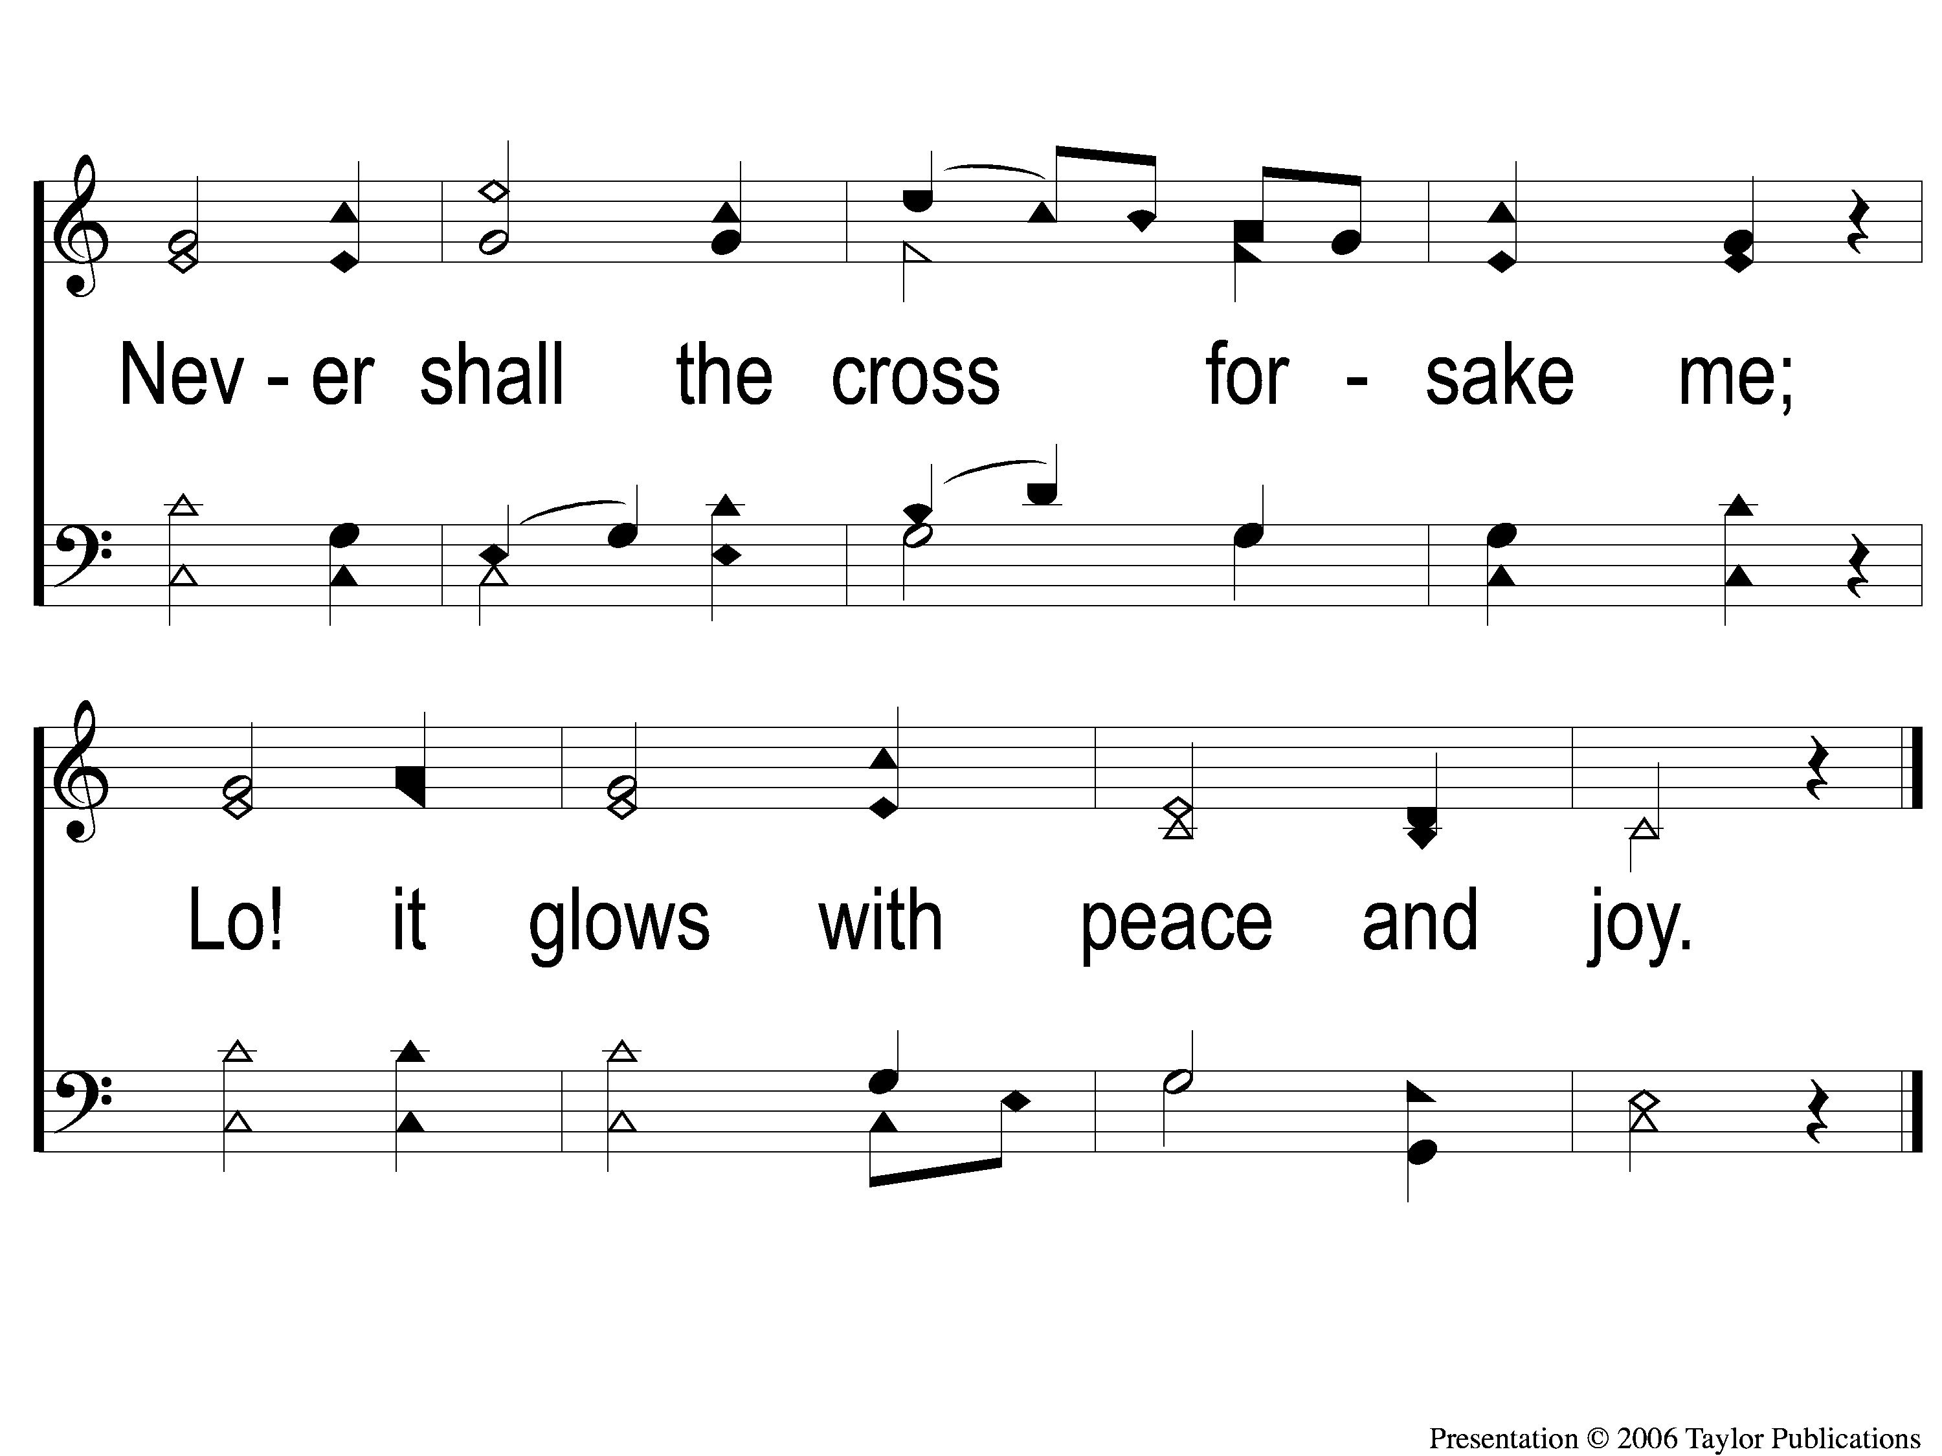
2-2 In the Cross of Christ
In the Cross of Christ I Glory
116

Slide 5
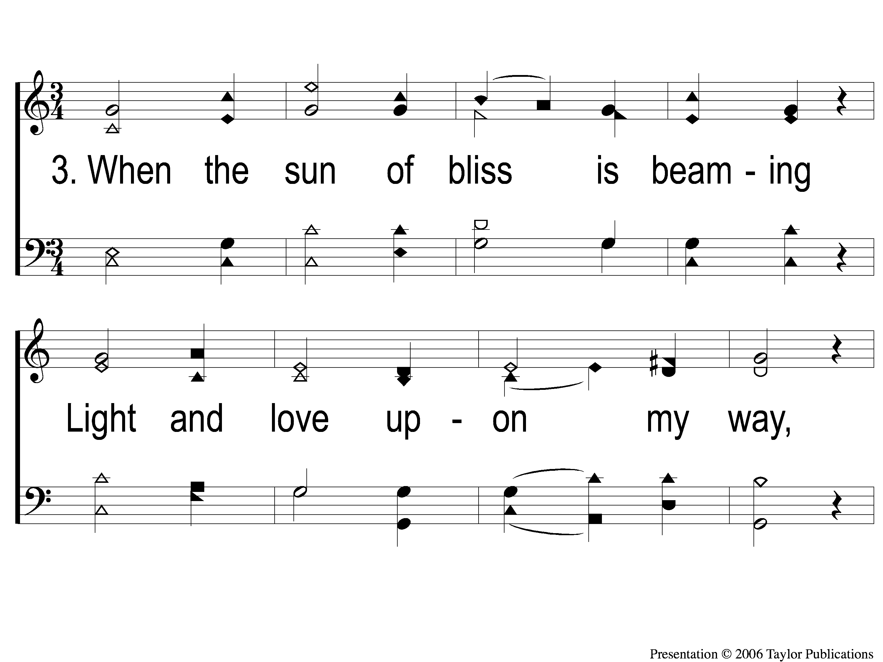
3-1 In the Cross of Christ
In the Cross of Christ I Glory
116

Slide 6
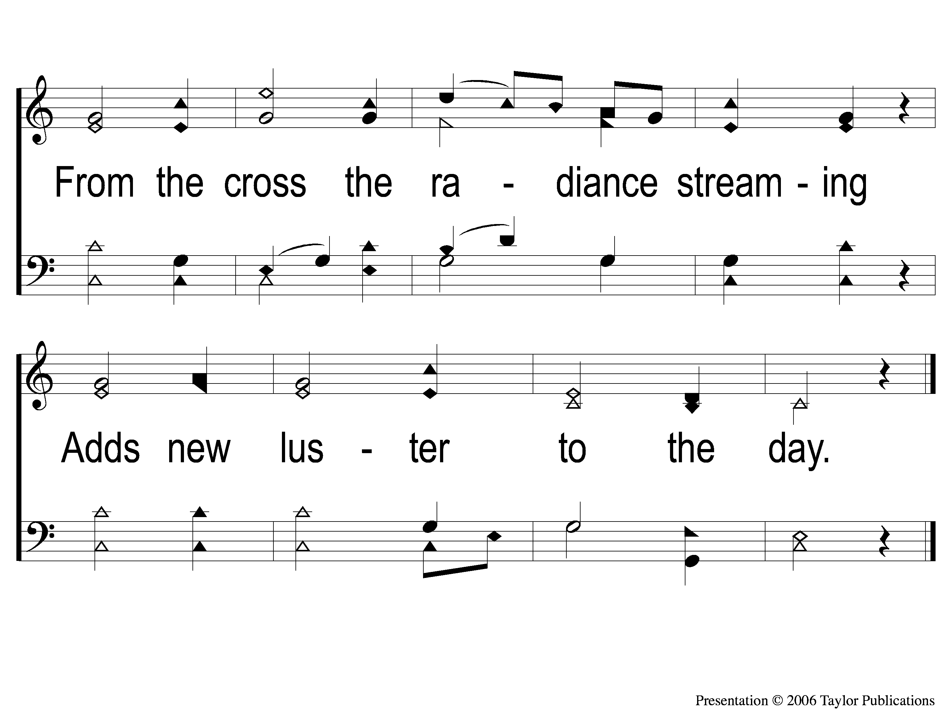
3-2 In the Cross of Christ
In the Cross of Christ I Glory
116

Slide 7
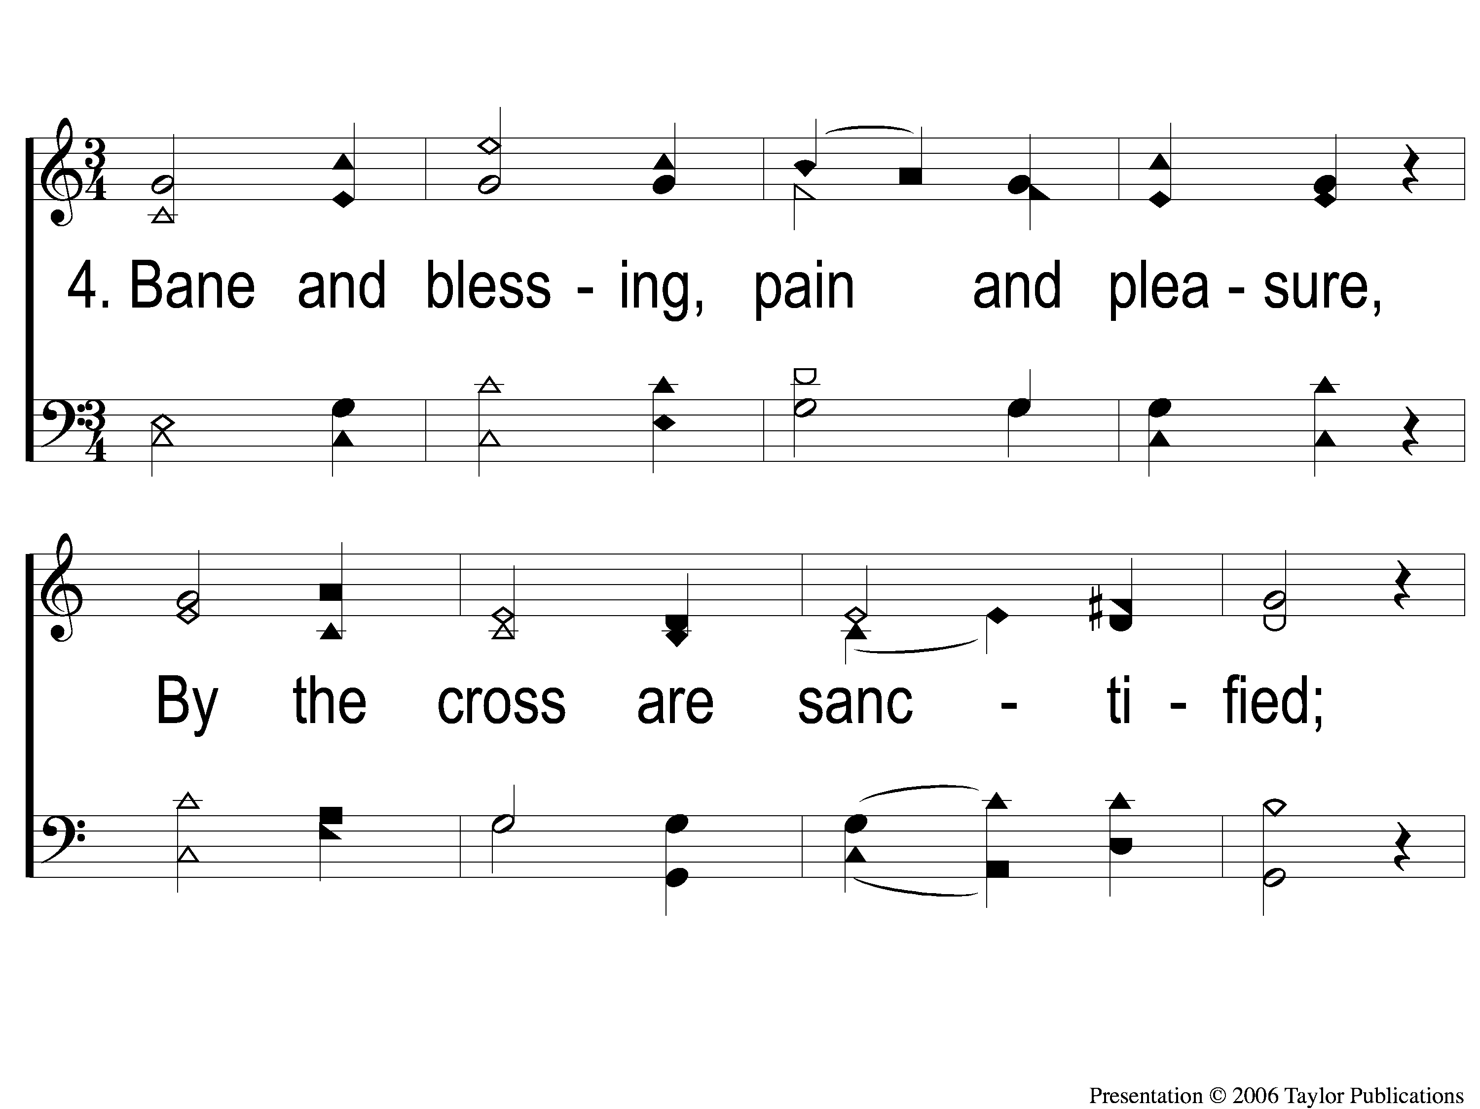
4-1 In the Cross of Christ
In the Cross of Christ I Glory
116

Slide 8
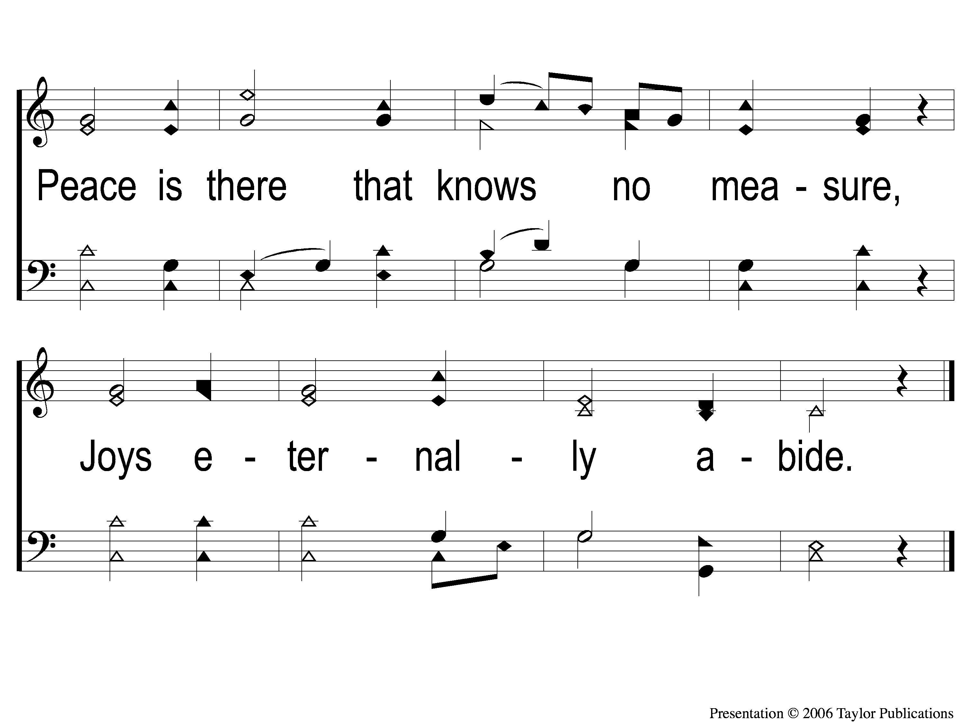
4-2 In the Cross of Christ
In the Cross of Christ I Glory
116

